Slide 1
Highlights in Reading Comprehension Intervention Research for Students with Learning Disabilities
By Linda H. Mason and Jessica L. Hagaman
Presentation by Marta van de Mond

Slide 2
Reading comprehension is the “essence of reading” (Durkin, 1993)
Reading comprehension is essential for understanding texts for Social Studies and Science.
Reading comprehension assists in learning Math.
Reading comprehension decides upon success in society.
It is estimated that 90% of high-wage jobs require post-secondary education.
Employment might be limited without strong literacy skills.

Slide 3
Reading Comprehension for Students with Learning Disabilities
LD student have challenge with:
Meaning of text
Relating text to prior knowledge
Making inferences
Identifying main ideas

Slide 4
LD students do not have strategies to read and do not engage in monitoring what they read due to struggling with the actual reading process.
Additionally, they confuse narrative and expository readings requiring different reading strategies. Therefore, LD students lose comprehension of the read material.

Slide 5
Impact of Decoding and Fluency on Comprehension
Reading requires:
Word or text decoding
Fluency
Vocabulary knowledge
If there are problems in any one of the above requirements, the reader spends too much time and effort on the process of reading and all the cognitive process is spent, leaving no space for comprehension. Also, if the process is that difficult, motivation to read is compromised. In order to improve comprehension there should be intervention for decoding and fluency.

Slide 6
Research?
60 students grades 4-8 were taught how to “Reread-Adapt and Answer-Comprehend” (RAAC).
The questions students had to read were:
Who is the main character?
Where and when did the story take place?
What did the main character do?
How did the story end?
How did the main character feel?
After four months of instruction students’ fluency and comprehension has improved (Therrien et al., 2006)

Slide 7
Narrative Text
Narrative pieces come in various forms:
Aural presentation
Pictures
Television
Text
Story grammar of narrative piece:
Characters
Setting (time and place)
Action or problem
A conclusion or solution
Emotion

Slide 8
LD students have challenge with identification of what’s important in the story, its theme, structure components including setting and plot.
Narrative Text Interventions:
Story Mapping
Self-Questioning Interventions
Story Grammar for a Read Aloud
Combining Comprehension Interventions

Slide 9
Story Grammar for a Read Aloud Research
According to various research, reading stories out loud to students, with preparing for and explicit teaching of Story Grammar prior to reading, supports LD learners in reading comprehension.

Slide 10
Story Mapping (visual representation or graphic organizer) Research
Comprehension is much improved with using story mapping, providing that explicit instruction in story retelling, both orally and in writing, takes place.

Slide 11
Self-questioning (before, during, and after reading) Research
According to some research, self-questioning surpasses story mapping (Taylor et al., 2002) in comprehension results.
Themes Instruction Program (Williams et al., 2005) includes:
Discussion before reading
Story reading (aloud to a younger student)
Self-questions for discussing key elements
Story theme identification and generalization to a variety of situations
Theme knowledge and story structure transfer to other story examples and/or real-life experience
Students of different ages participated in different
studies and results were very successful for all
groups; however, theme was still elusive to LD
students.

Slide 12
Combining Comprehension Interventions
Research # 2 (Faggella-Luby, Denton, and Deshler, 2007)
Heterogeneous group of gr. 9 students – 14 with LD
Embedded Story Structure (ESS) – self-questioning, story structure analysis, and summarizing
Comprehension Skill Instruction (CSI) – strategy use and story structure knowledge
Random samples used different strategies: ESS was much higher (ES=.78) than CSI regardless of LD presence or absence
Explicit instruction and grammar strategies support comprehension in LD students, but story retelling, theme development, and writing requires more intense instruction for the LD group.
Research # 1 (Johnson, Graham, and Harris, 1997)
47 LD students grades 4-6
Story grammar: Who, When, Where, What did the character(s) do?, What happened next?, How did the character(s) feel?, How does the story end?
Comparison to explicit instruction for self-regulation for goal setting, self-instruction, , or goal setting and self-instruction
However, story grammar supported comprehension, self-regulations could not be tested due to intensity of support.

Slide 13
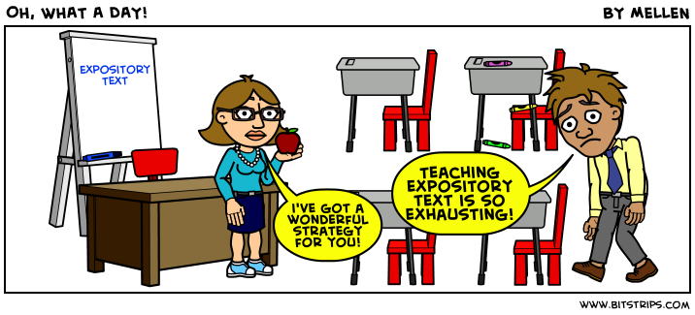
Expository Text
Inconsistent style
Communicating truth or empirical facts, theories, and dates
Unfamiliar text structures (lists, compare/contrast, time-sequence, procedural, problem-solution, classification, concept, cause-effect)
Conceptual density
Difficult vocabulary
Expectation of prior knowledge

Slide 14
Expository Text Supports
Text Enhancements
Graphic Organizers
Cognitive Mapping
SM, SFA, SSFA
Visual Display
Mnemonics
Computer Assisted Instruction
Cognitive Strategy Instruction
Main Idea Identification and Summarization
Self-Questioning
Paraphrasing
Summarization
QAR
Text Structure Instruction
Multicomponent Interventions
Multipass
POSSE
TWA

Slide 15
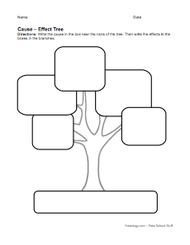
Text Enhancements assist students in identification, comprehension, and recalling key information. LD students adapt to different styles of text enhancements.
Graphic organizers
There are 5 categories (Dexter & Hughes, 2011):
Cognitive mapping
Semantic mapping (SM)
Semantic features analysis (SFA)
Syntactic/semantic features analysis (SSFA)
Visual display
Graphic organizers seem most useful in studying Science (Dexter & Hughes, 2011).
Cognitive mapping links ideas with lines, arrows, and spacial arrangements. It supports students comprehension.
SM demonstrates link between superordinate concepts with coordinate concepts as collaborated by teacher and students. SFA replaces key vocabulary with cloze sentences. In seven experimental studies Bos, Anders, and others (1990, 1992) found that SM, SFA, and SSFA had immediate positive effects, but no long term effects on comprehension, vocabulary, written retell.
Visual display can be a timeline or a life cycle for example. Studies show that visual organizers help students more than just factual listing; however, geometric shapes can be confusing to LD students and researchers caution that visual organizers have to be well thought out to support this group (Griffin et al., 1991)

Slide 16
Text Enhancements continued…
Mnemonics
LD students learn to improve retention of essentials in expository text by:
Insertion of mnemonic illustrations next to descriptive illustrations
Mnemonic method – using keyword such as conquer to learn conquistador (Mastropieri, Scruggs, & Fulk, 1990)
Based on four separate studies ran mainly by Mastropieri and Scruggs, it was proven that Mnemonics support LD students’ comprehension (ES=1.62)
Computer Assisted Instruction
Based on two separate studies from 1995 and 1996, Computer Assisted Instruction had a small effect on improving comprehension. The techniques were used to
Highlight main ideas
Pose visual questions
Receive teacher’s comments and notes
Access a glossary
With computer technology having daily progress, perhaps today this method would be more successful.

Slide 17
Cognitive Strategy Instruction gives best results for LD students.
Main Idea Identification and Summarization includes:
Self-questioning
Paraphrasing
Summarization
Question-Answer Relationship – QAR
Self-questioning has 5 steps:
Question: What are you studying this passage for?
Finding and underlining the main idea
Thinking of a question about the main idea
Learning an answer to the question
Looking back, and questions and answers
The study of gr. 8 and 9 students had small results of ES=.49, but the process laid the groundwork for cognitive strategies for LD students. (Gajria et al., 2007)
Paraphrasing
RAP – instruction to find a main idea
Read a paragraph
Ask yourself what the paragraph was about
Put the main idea and two details into your own words
The paraphrasing technique has improved cognition in LD students.

Slide 18
Cognitive Strategy Instruction continued…
Summarization five step approach (Brown & Day, 1983)
Delete trivial information.
Delete redundant information.
Substitute super ordinate terms for a list of terms.
Select a topic sentence.
Invent a topic sentence.
This method works for Social Studies texts (Malone & Mastropieri, 1992). However, it is best when used with self-monitoring techniques.
QAR – Question-Answer-Relationships was tested in LD students in grades 1-9 (Simmonds, 1992). Students were answering three types of questions in Social Studies. The QAR method proved to improve comprehension in LD students.

Slide 19
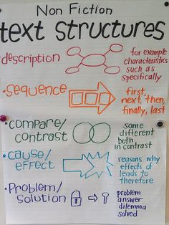
Text Structure Instruction
With TSI training grade 8 LD students had success with understanding three passage types:
Main idea
List
Sequence of events
(Bakker, Mastropieri, and Scruggs, 1997)
The students were taught highlighting keywords and finding strategy clues in text.
The Text Structure Instruction combines different components like clue words, graphic organizers, and questioning. Training for TSI can transfer knowledge to different expository readings.
Text Structure Instruction

Slide 20
Multicomponent Interventions
Strategies for:
Prior knowledge acquisition
Comprehension monitoring
Summarization of information throughout reading
(Baker, Gertsen, & Scanlon, 2002)
Reciprocal Teaching Procedures: predict, question, clarify, and summarize (Palinscar & Brown, 1984)

Slide 21
Multicomponent Interventions continued…
Multipass
Students are taught how to review chapter materials with the following steps:
Survey
Size up
Sort out
In the survey part, students summarize material, in sizing up they answer questions and paraphrase, then they test their understanding by sorting out.
The strategies include:
Pre-assessment
Strategy description
Teacher-led modeling
Strategy memorization
Guided practice with controlled materials
Feedback
Progress assessment
Guided practice with grade level materials
Feedback
Progress assessment
Multipass was successful with 8 LD students in one subject study. (Schumaker et al., 1984)
POSSE
Predict (from titles, headings, pictures, keywords, and brainstorm predictions)
Organize ideas
Search for the text structure
Summarize the main ideas
Evaluate understanding (Englert &Mariage, 1991)
Graphic organizers with sentence stems: I predict that… were used with LD students gr. 4-6 were helpful in following free recall (Gajria et al., 2007)
TWA
Think before reading
While reading
After reading
In the first part students tap into their prior knowledge and ask questions about their reading materials. During the second part students monitor speed and comprehension of read materials. Finally they come up with main ideas and summaries of what they’ve read.
This strategy proved to have small positive effects for LD students.

Slide 22
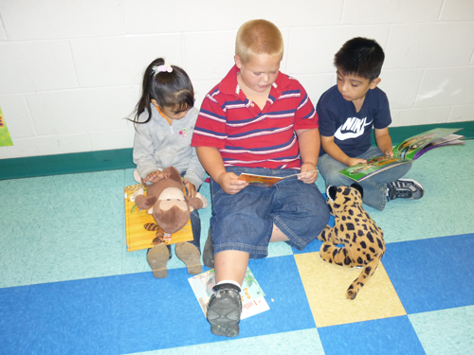
Peer-Assisted Intervention in the Inclusive Classroom
Two strategies have been tested:
Collaborative Strategic Reading (CSR)(Klinger & Vaughn, 1996)
Peer-assisted Learning Strategies (PALS)(Fuchs & Fuchs, 2006)
CSR includes the whole class instruction followed by small group work. The three strategies are implemented: Click and Clunk, Preview, and Wrap Up. According to research, CSR can work only with intensive training and coaching provided by teachers (Hitchcock et al., 2010).
PALS has students reading in pairs. Instruction includes:
Partner reading with 2 min. retell
Paragraph shrinking
Prediction relay
After 15 years of research, it turns out that more than 50% of LD students are nonresponsive to PALS intervention

Slide 23
Discussion
Troubling statistics: only 33% of fourth graders, 34% of eighth graders, and 38% twelfth graders perform above proficiency in reading (National Center for Education Statistics, 2009).
For reading intervention to be successful, it has to begin in the early grades, not when students are showing signs of struggle.
Comprehension instruction has to be included in fluency instruction.
Lots of research-based strategies in comprehension studies proved to be ineffective in the long run.
Unless there is explicit, uniform instruction to teachers how to use different strategies, they do not work with LD students. LD students themselves may prefer and work better with one strategy over another.
Once the strategies are begun, they need to continue to be effective.
Is there sufficient time considering class size to implement sound comprehension instruction to our LD students?

Slide 24
Any Questions?

